Slide 1
Course on ‘Creativity and Innovation’ @ Delhi, India 17th July 2015
Group - 6
Team - Krazy 4

Slide 2
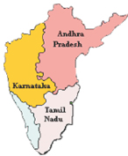
Team Members
P REDDY GURUNATHA SWAMY
BHAVANI
Educational background: B.Tech
Institute: KL University, Vijayawada
NCAT roll number: 16985 (Category-1)
Educational background: B.Tech
Institute: Sona College of Technology, Salem (Category -3)
KIRAN KARPUR
Educational background : PGDM
Institute: Indo-German Training Center , Bangalore
NCAT roll number: 12699 (Category-4)
P HEMANTH SAGAR REDDY
Educational background: B.Tech
Institute: KL University
NCAT roll number:16419 (Category-2)

Slide 3
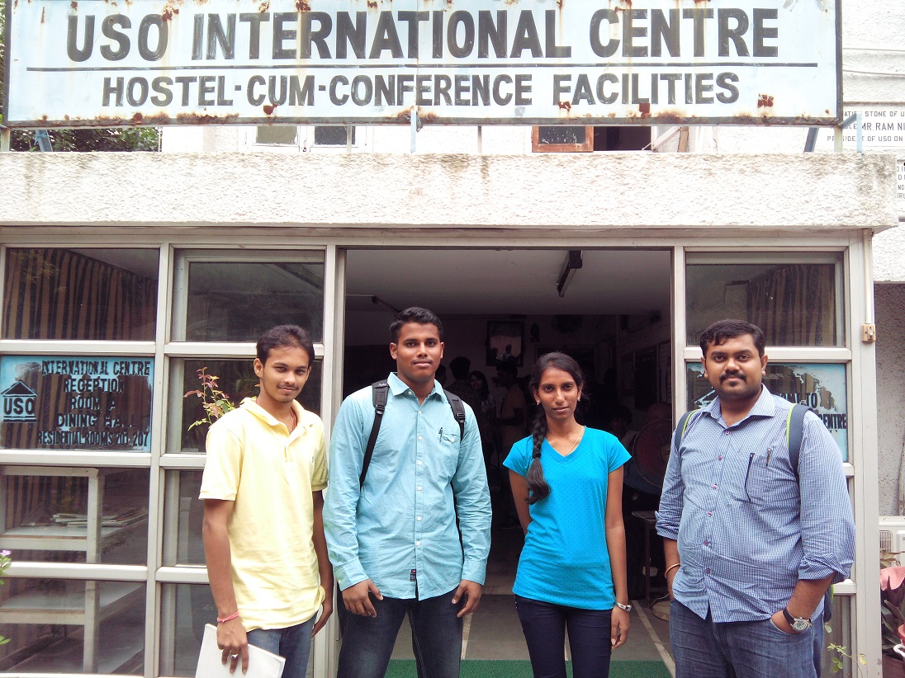

Slide 4
Our 3 Best Thoughts
1) An All-in-one digital smart card for India
2) To solve water problems in areas with very little rain and low levels of groundwater
3) To solve the basic electricity problem in poorest & backward pockets of India

Slide 5
Our Choice
To solve the basic electricity problem in poorest & backward pockets of India

Slide 6
Background
Electricity is one of the most basic need of the hour in major regions of India. It is used not only for lighting and household purposes, but it also allows for mechanization of many farming operation
Rural areas in India are electrified non-uniformly, with richer states being able to provide a majority of the villages with power while poorer states still struggling to do so
Poverty, lack of resources, lack of political will, poor planning and electricity theft are some of the major causes which has left many villages in India without electricity

Slide 7
Background (contd..)
The central government is increasingly trying to improve the dire conditions by investing heavily in biogas, solar as well as wind energy
Programs such as The JNN solar mission, Pradhan Mantri Gram Vidyut Yojna are essential
Northern and North Eastern states in India are lagging behind the national average bringing the numbers down, primarily due to inefficient state governments and lack of economic resources; these states are currently the focus of many NGOs as well as state programs
It is estimated that 12 GW of solar power will be required for the 1 lakh electrified villages in the country

Slide 8
Problem Statement
“ Backward pockets of India need an affordable solution for electricity woes, since it is one of the basic needs for household applications such as lighting, etc., to improve their overall quality of life ”
WHO ?
WHAT ?
WHY ?
needs
because

Slide 9
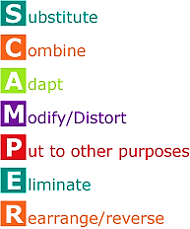
Substitute
For Solar electric products
Modify/Minify
We minified the large wind turbines into a small portable model

Slide 10
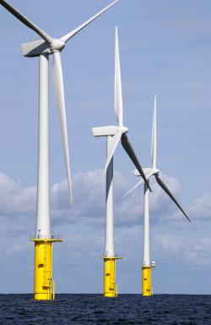
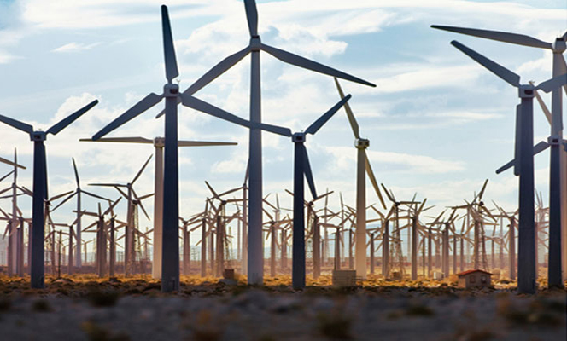

Slide 11
Creative solution
“To make a portable, telescopic, foldable and affordable – small size wind turbine for generation of enough electrical energy for a single bulb to run for an entire day for one household”

Slide 12
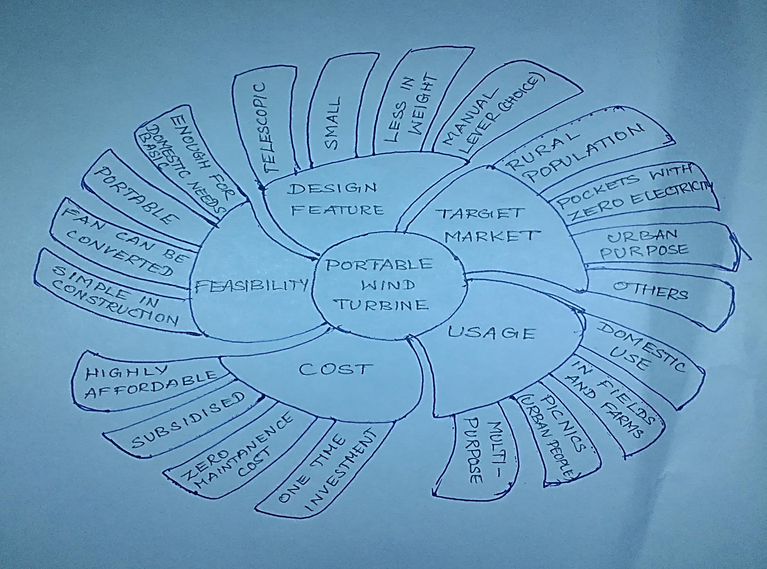
Mind Mapping

Slide 14
The Six thinking hats
White hat → Power shortage problem in India; Electrical energy requirements
Yellow hat → Simple, affordable & feasible design for product
Green hat → Multipurpose possible; Portable; usable with a manual lever

Slide 15
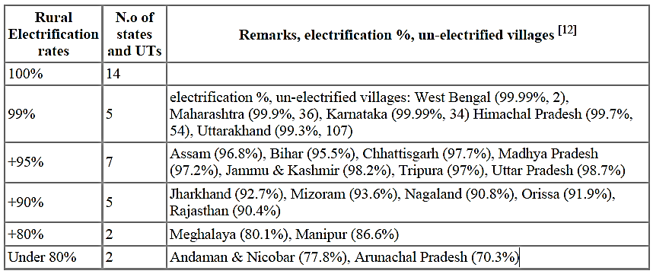
The six thinking hats(contd.)

Slide 16
The six thinking hats(contd.)
Black hat → May not work in areas with very low wind; May not be easy to use by a layman; Marketing Problems
Blue hat → The process of electricity generation is simple and the device is not complex
Red hat → Without electricity people suffer; This Idea will work with a strong belief in intution

Slide 17
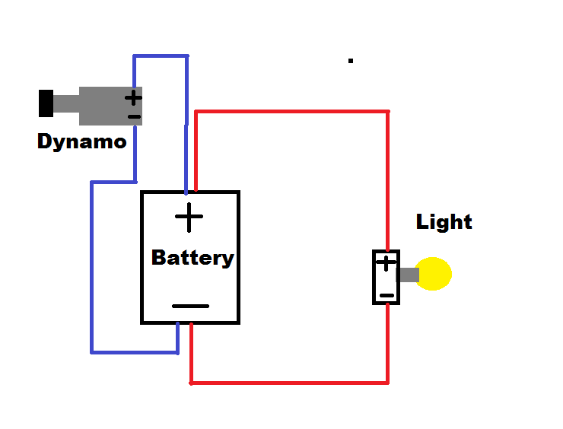
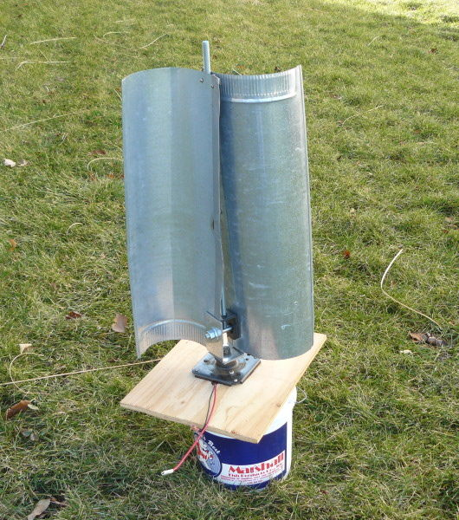
Our Creative Product PWT

Slide 18
PWT Attributes
Structure/Framework
Stainless steel
Aluminium
Wind turbine material
About 3 – 4 foot tall
Size & weight
Composites (Fibre)
Portable
Plastic material
Mild steel
Carbon Fibre composites
Telescopic
Other applications
On car tops
In urban households & other domestic usage
Military use
Max. 2 kg (excluding battery)
Dia – 1.5 m (max.)

Slide 19
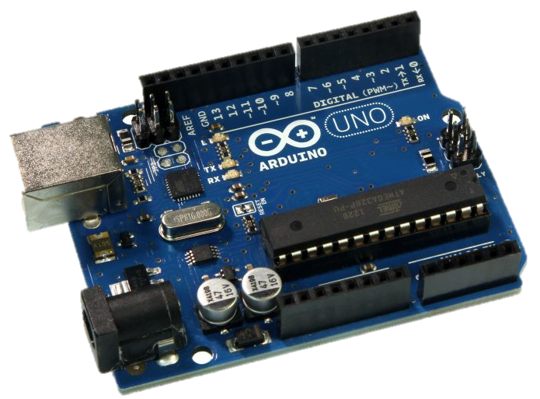
Eagle Eye App to regulate our PWT
For urban application of the same product we would insert an ARDUINO CHIP so that the user will be able to keep track of the electricity being generated in his absence also and use it accordingly
The rural version will not have the chip installed because it is an unnecessary feature and a costly affair to afford another 700 rupees for the chip
The urban user can place the device any place where wind is available in good amounts and then connect it to the app-EAGLE EYE, to know how many units of electricity is being generated by the device
Using real time servers we can upload the API of the ARDUINO CHIP and connect it to the owner’s app to sync data between the two
An APP to keep eye on everything

Slide 20
What help do we need ?
Financial Help
Marketing Help
Strategic Know-How

Slide 21
References
Internet – Google Images
Wikipedia
Verticle Axis Wind Turbine, Book by Mr. Rabejha

Slide 22
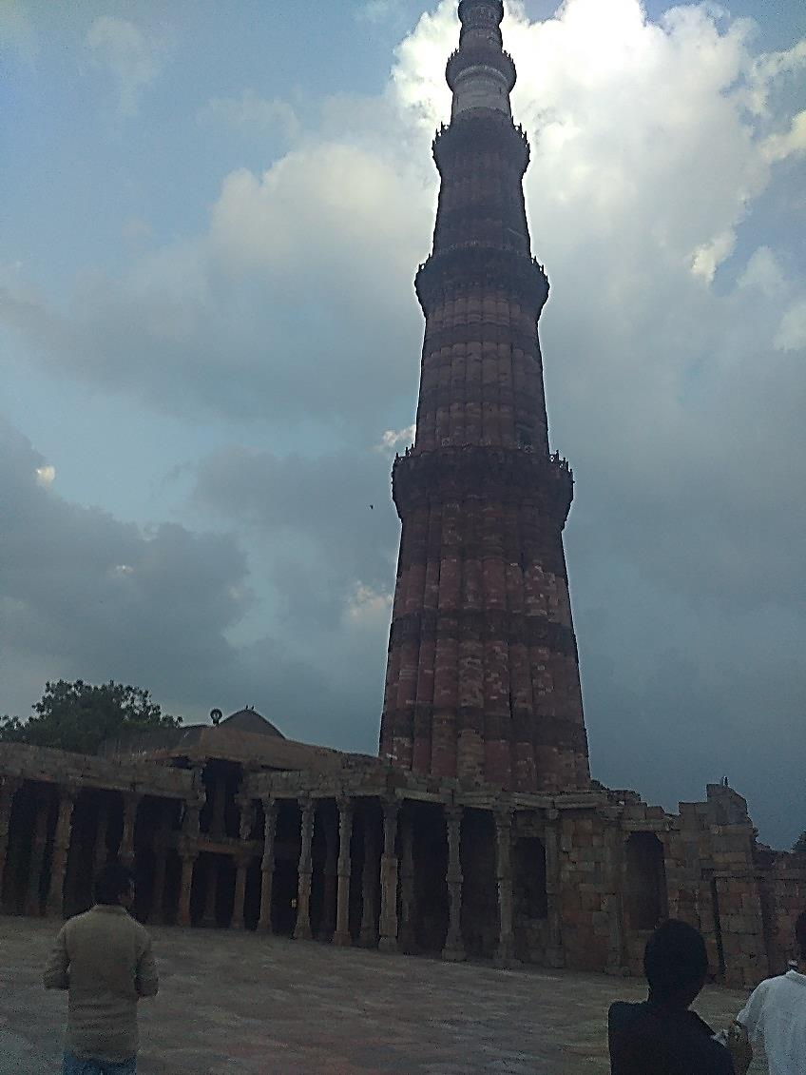
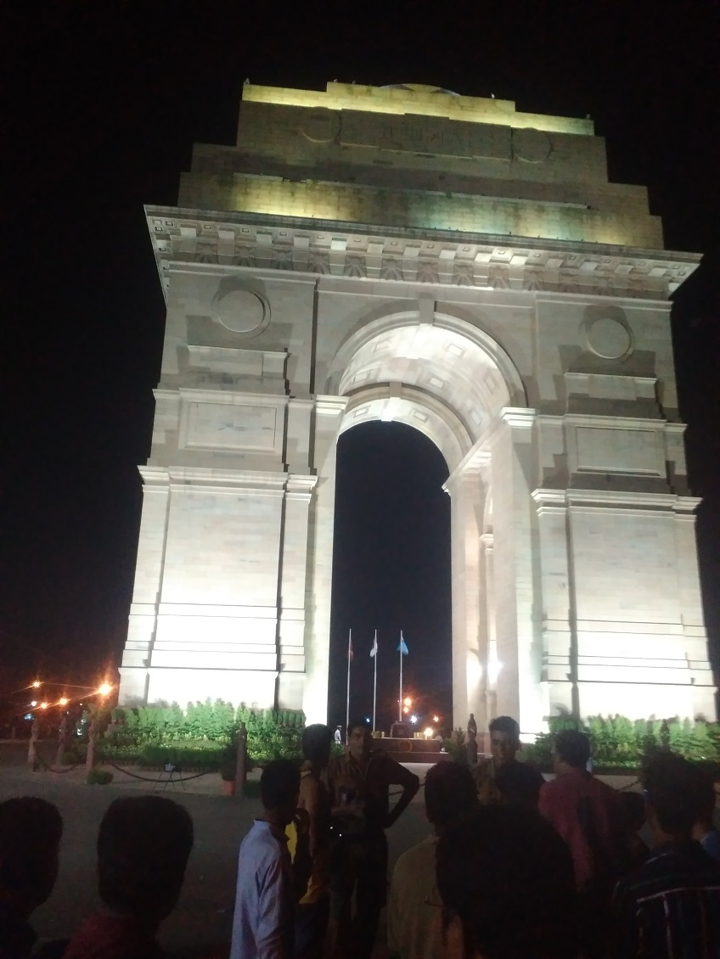
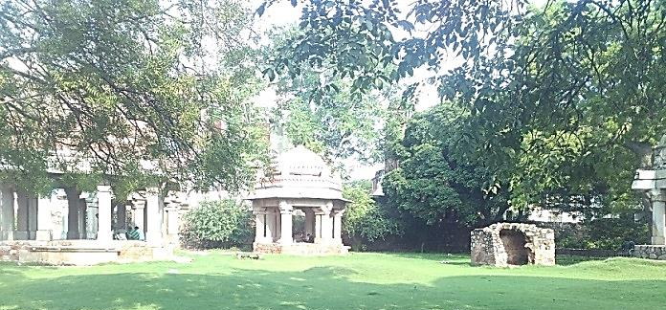
Thank You… Team – Krazy 4

